Slide 1
SINGAPORE WASTE MANAGEMENT
Ng Wee Herng(2214296), DAAA/FT/1B/01, PDAS CA2

Slide 2
Datasets Used
https://data.gov.sg/dataset/solid-waste-management-total-domestic-waste-disposed?view_id=f83aa272-974c-4c0f-b6d9-421c1eb200fe&resource_id=2c6749c6-8271-4281-97ff-fb089cccf0c4 (Total Domestic Waste Disposed)
https://www.kaggle.com/datasets/kingabzpro/singapore-waste-management?select=2003_2017_waste.csv (Waste from 2003 to 2017)
https://www.kaggle.com/datasets/kingabzpro/singapore-waste-management?select=2018_2020_waste.csv (Waste from 2018 to 2020)
https://www.macrotrends.net/countries/SGP/singapore/carbon-co2-emissions (Singapore CO2 Emissions)

Slide 3
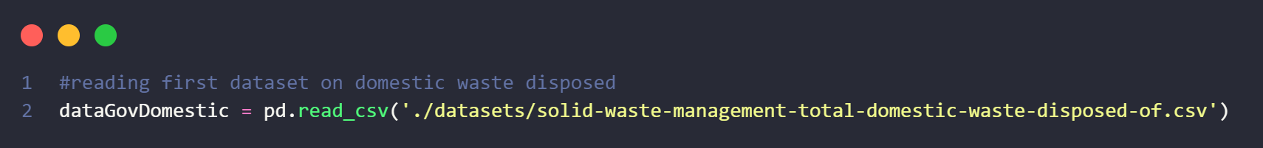
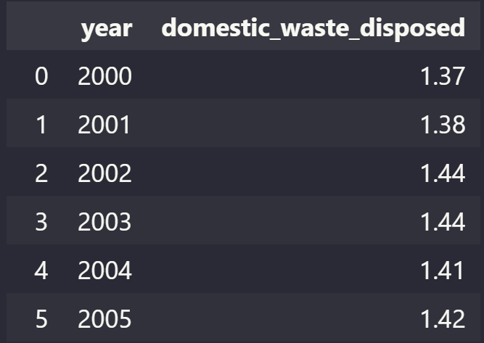
Dataset 1
Solid Waste Management - Total Domestic Waste Disposed (2000-2015)
Contains
Year → Year data was collected
Total Domestic Waste Disposed → In Million Tonnes

Slide 4
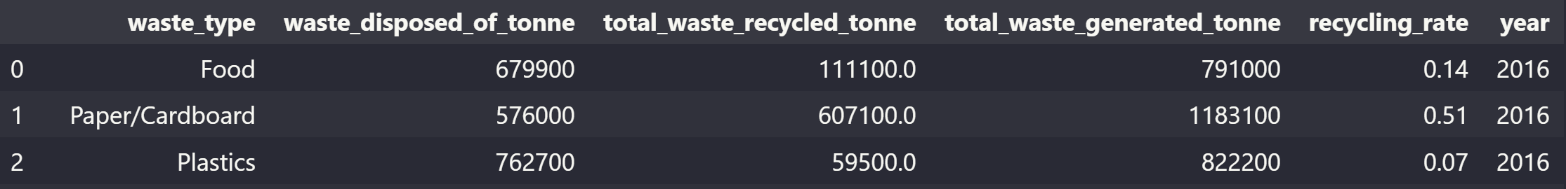
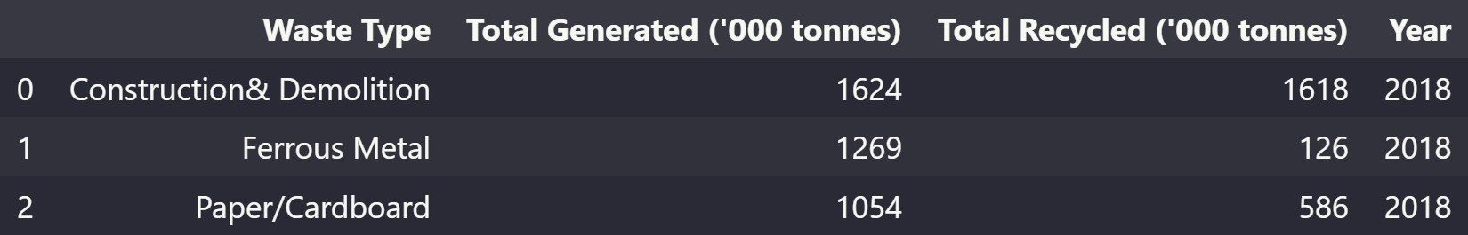
Datasets 2 and 3
Waste Management from (2003-2017) and (2018-2020)
Contains
Waste Type
Total Generated Waste
Total Recycled Waste
Year

Slide 5
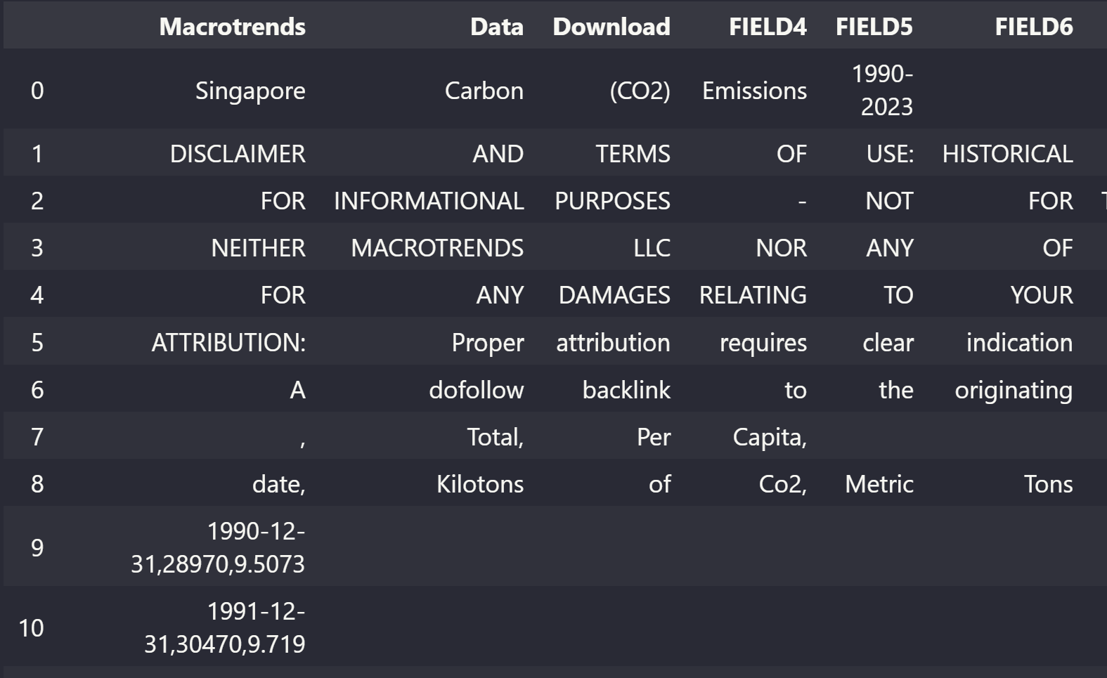
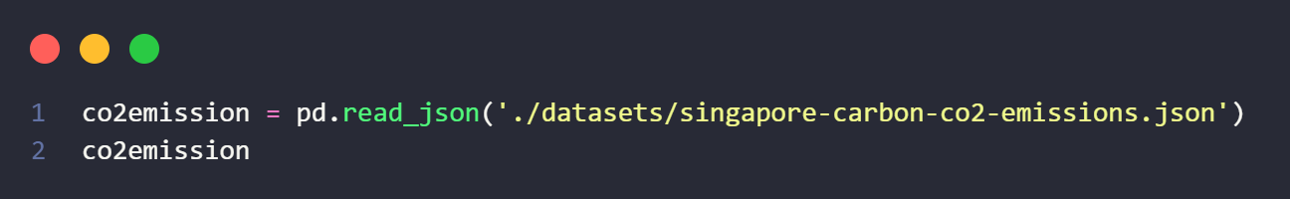
Dataset 4
Singapore’s Carbon (CO2) Emissions
Converted to JSON to read with pandas
Contains
Year, Carbon Dioxide Emissions

Slide 6
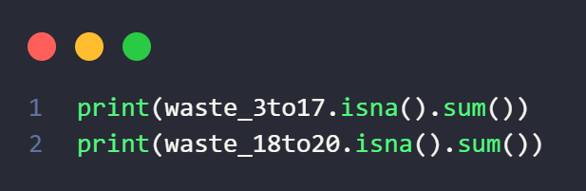
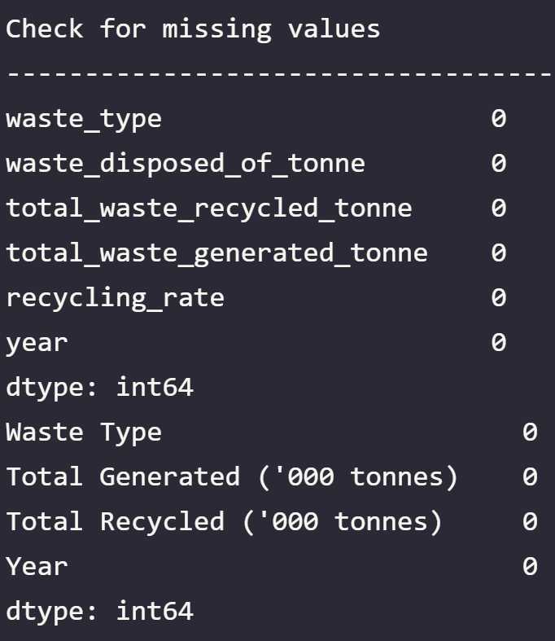
Cleaning Data (Waste Composition)
Check for missing values with is.na() function from pandas

Slide 7
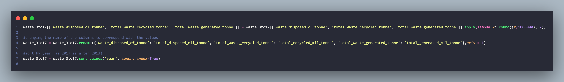
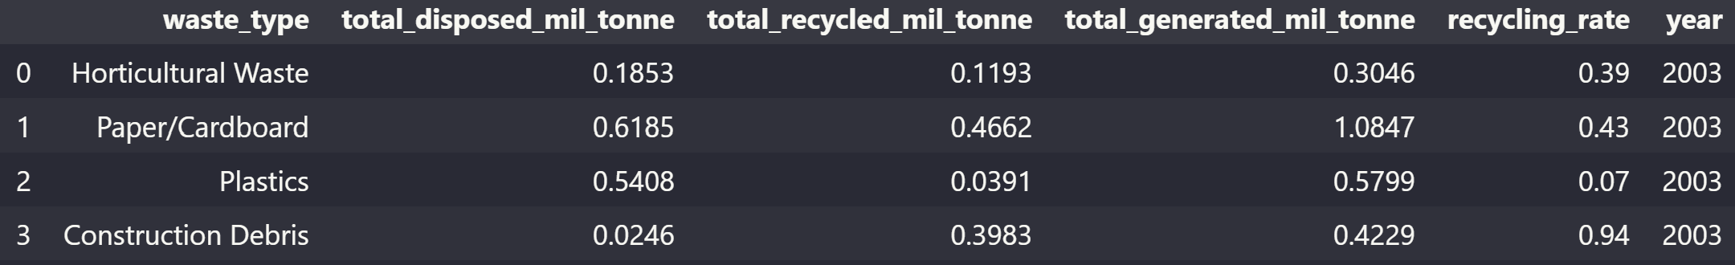
Cleaning Data (Waste 2003-2017)
Made all numerical columns from tonnes to million tonnes to standardize with all datasets → .apply(lambda function)
Renamed columns to standardize dataset 2 and 3 → .rename
Sort by year → rows were not sorted by year, making it a bit confusing (.sort_values)

Slide 8
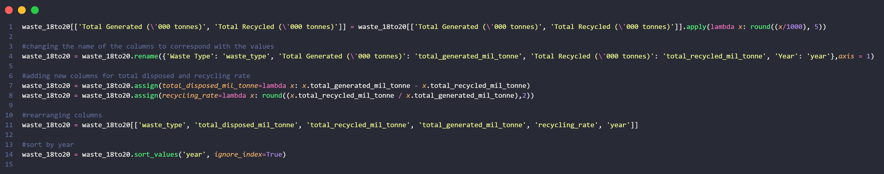
Cleaning Data (Waste 2018-2020)
Made all numerical columns from thousand tonnes to million tonnes to standardize with all datasets → .apply(lambda function)
Renamed and rearranged columns to standardize dataset 2 and 3 → .rename
Since dataset on waste from 2018 and 2020 did not include columns on generated waste and recycling rate, added those columns → .assign(colume_name = lambda function)
Sort by year → rows were not sorted by year, making it a bit confusing (.sort_values)

Slide 9
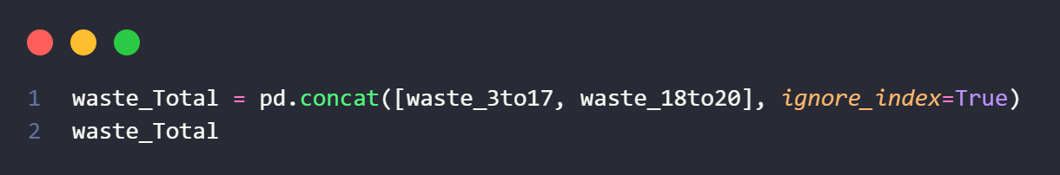
Cleaning Data (Waste Composition)
Combined the datasets into one dataset of waste composition from 2003 to 2020 with the pd.concat function

Slide 10
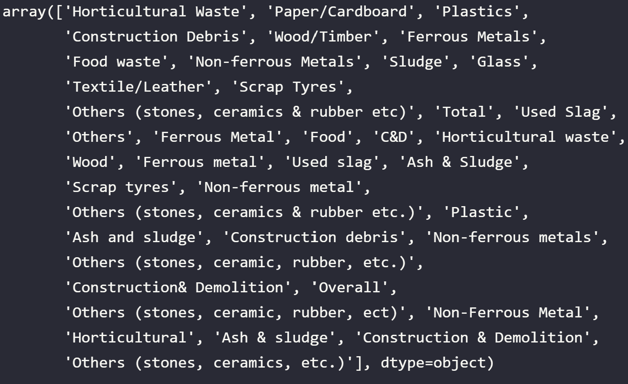
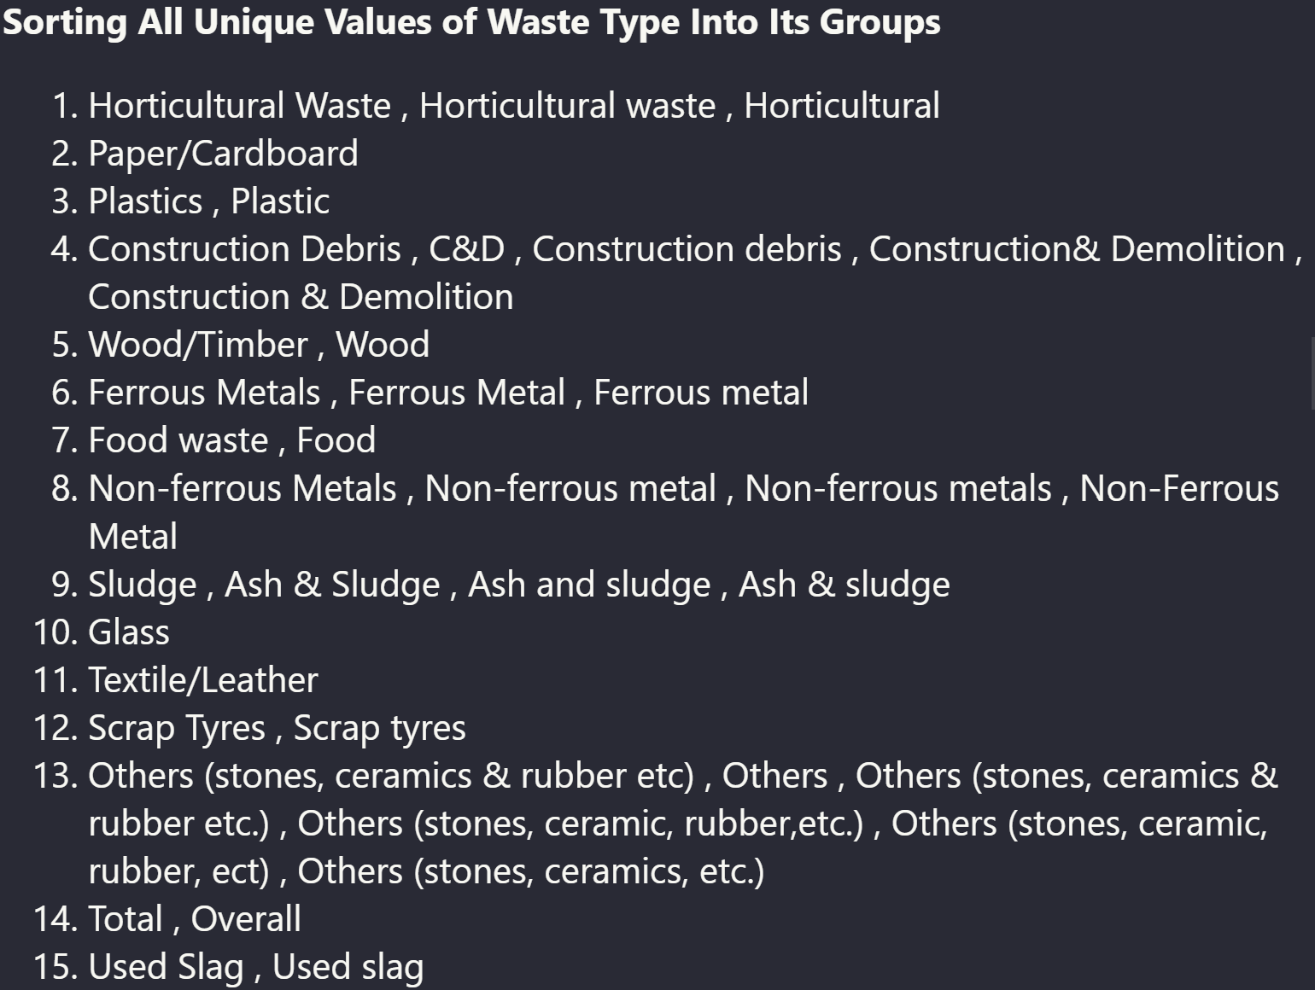
Cleaning Data (Waste Composition)
Checked for the number of different waste type names, found that there were many different names for the same waste
Sorted all values together

Slide 11
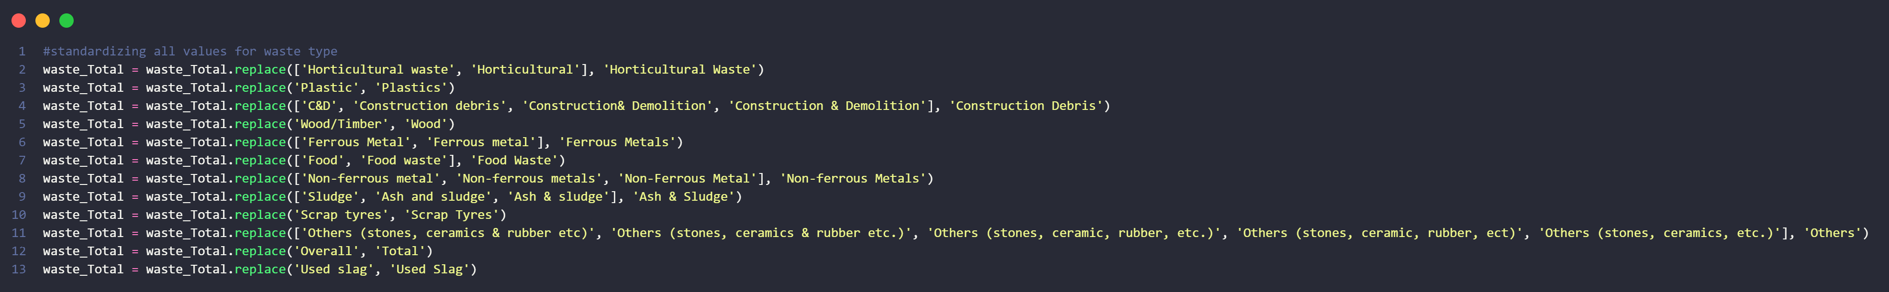
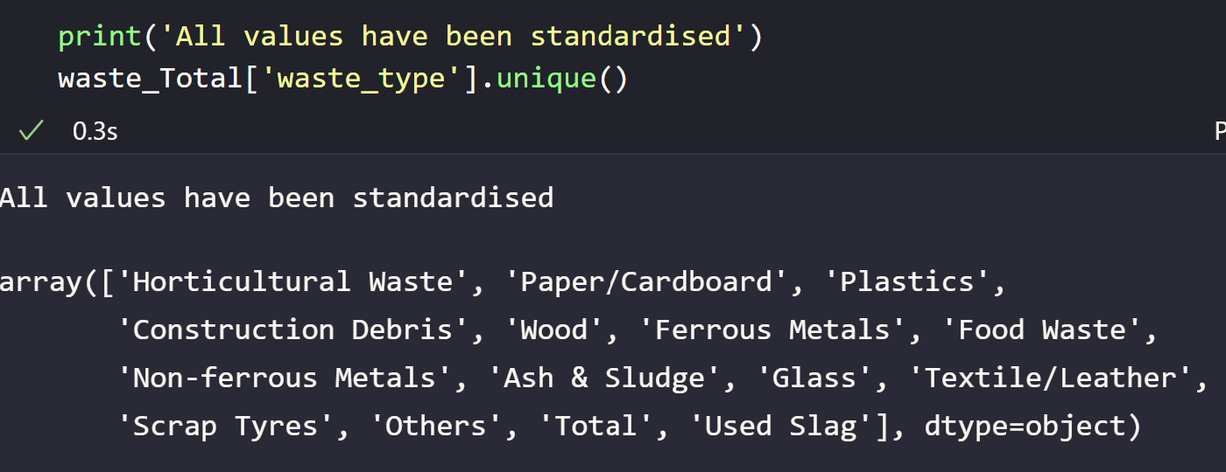
Cleaning Data (Waste Composition)
Standardizing the waste type names with .replace

Slide 12
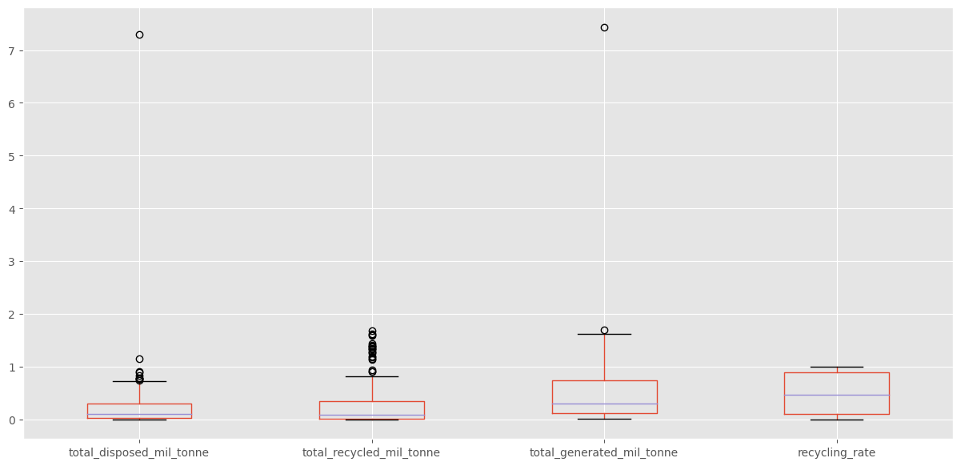
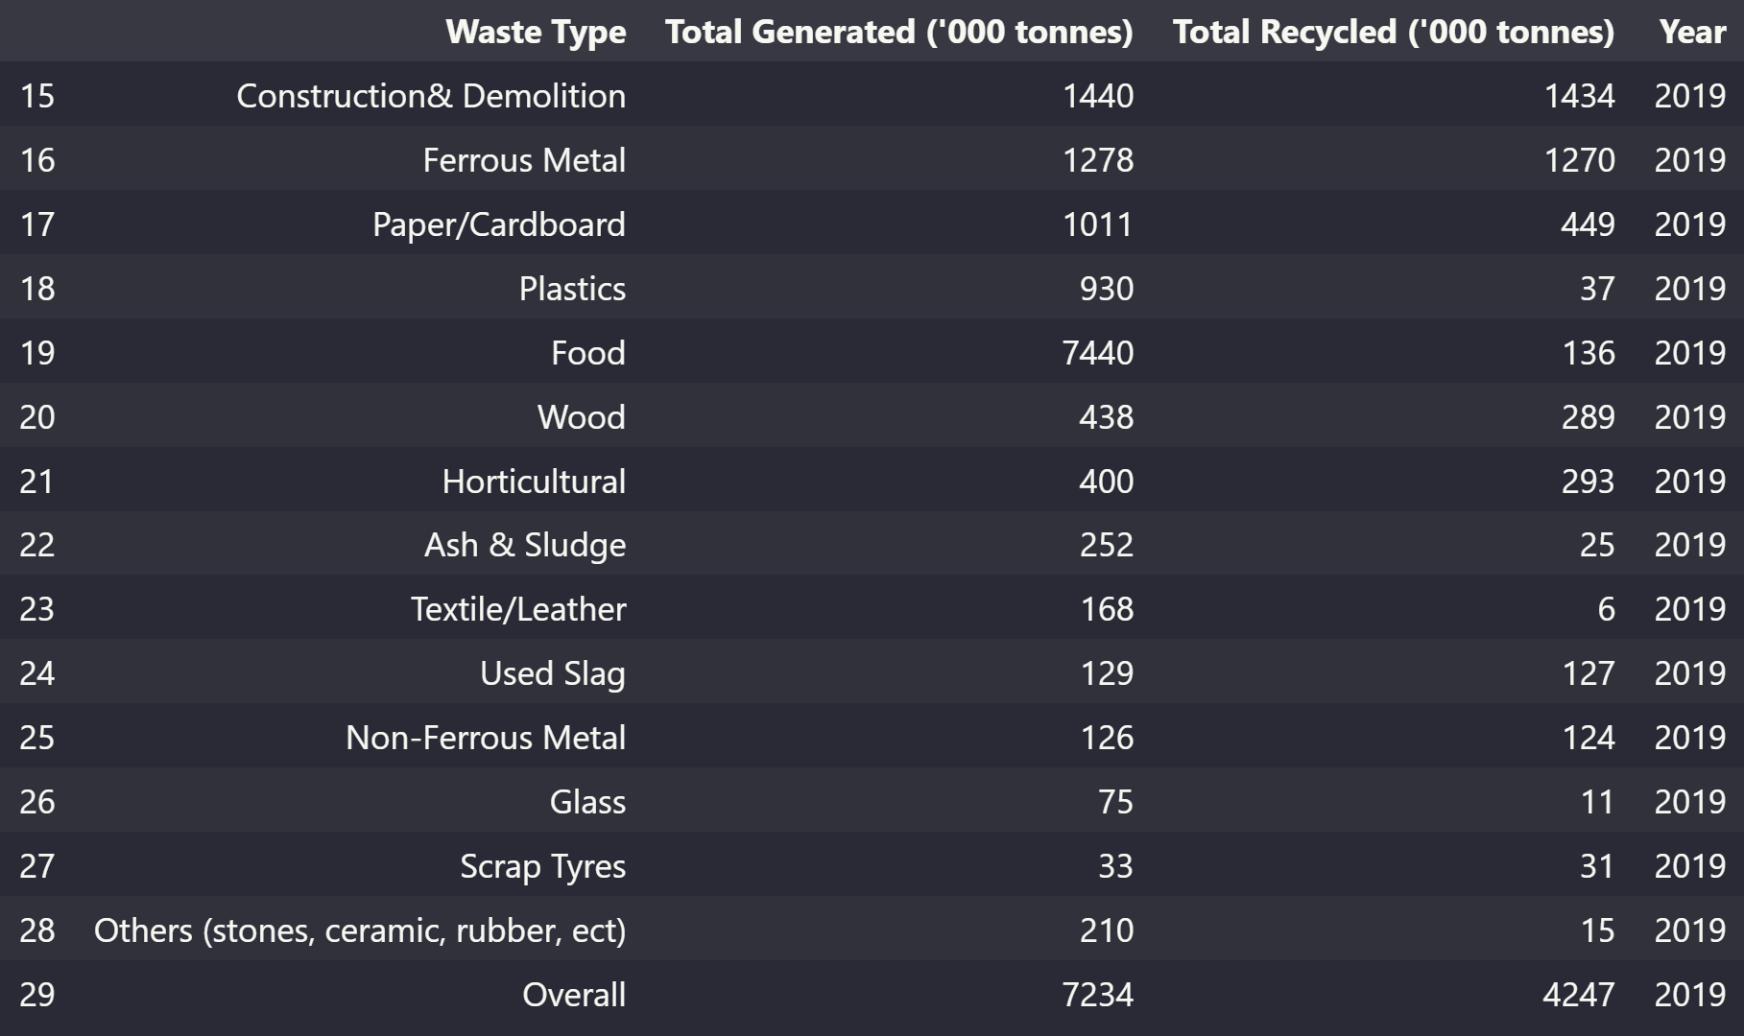
Cleaning Data (Waste Composition)
Check for outliers
Some look believable, but the there is one data point that has over 7 million tonnes of waste disposed and generated
Check for this value in the raw dataset

Slide 13
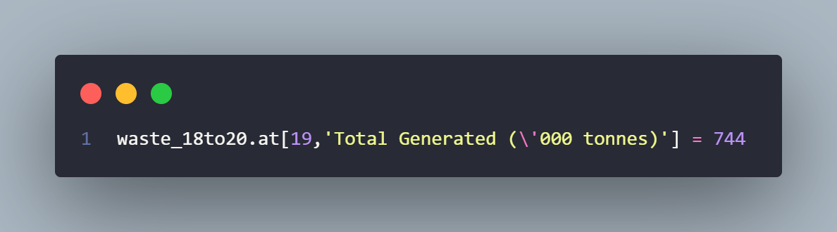
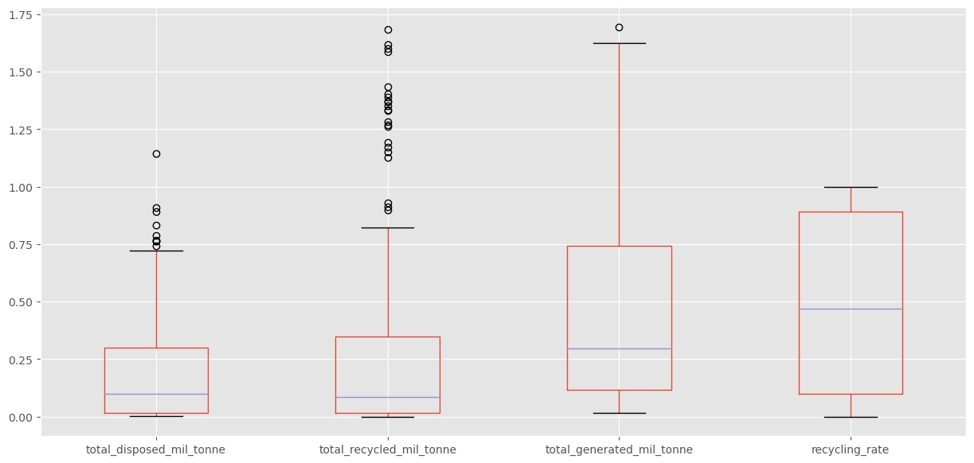
Cleaning Data (Waste Composition)
Check for outliers
Changed the value by subtracting all other waste values from the total
Ran cells again and checked for outliers

Slide 14
Why are remaining outliers kept
There are many types of waste, and some of them are used more than others leading to bigger numbers of generated waste.
There are many types of waste that can be recycled, and some may be easier to recycle or just have a larger quantity of waste for recycling leading to bigger numbers of recycled waste

Slide 15
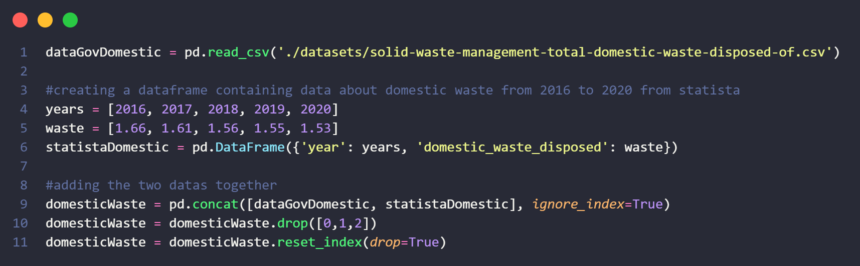
Cleaning Data (Domestic Waste)
Dataset only contains domestic waste in million tonnes from year 2000 to 2015
Added supplemental data from Statista by creating a dataframe and using pd.concat() (https://www.statista.com/statistics/628000/waste-disposed-in-singapore/ )
Followed years from waste composition dataset, changed to years 2003 to 2020 by dropping the first few columns → .drop

Slide 16
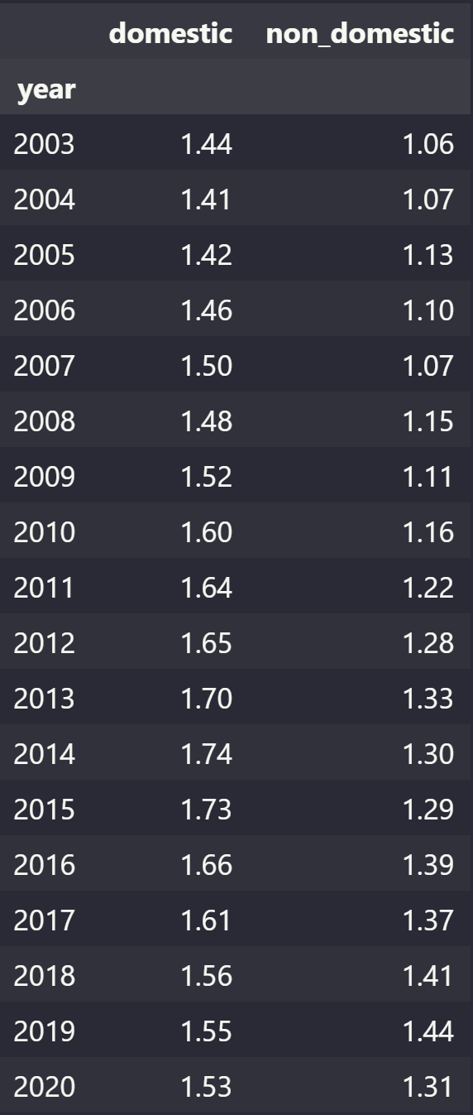
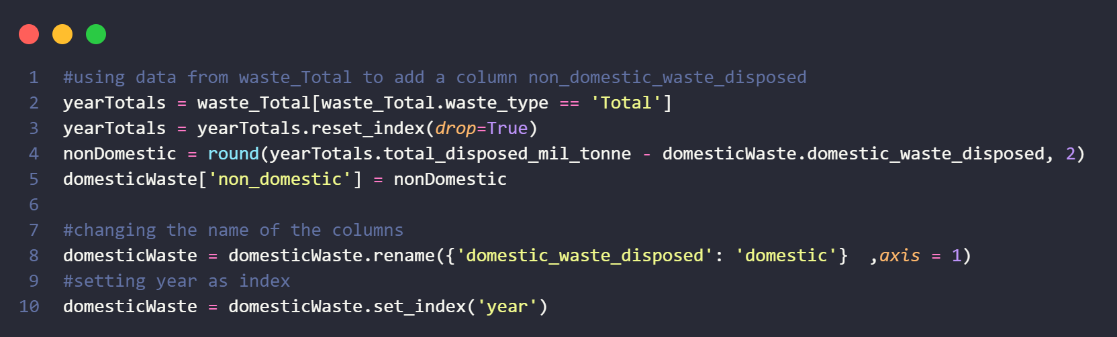
Cleaning Data (Domestic Waste)
Added another column on non-domestic waste, by using total waste disposed from previous cleaned dataset
Renaming columns for easier understanding

Slide 17
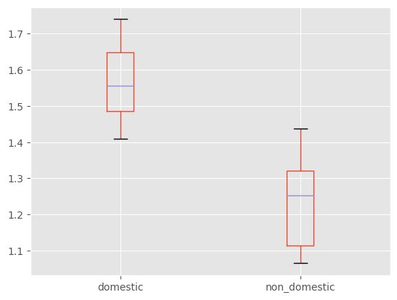
Cleaning Data (Domestic Waste)
Check for outliers
No outliers in this data

Slide 18
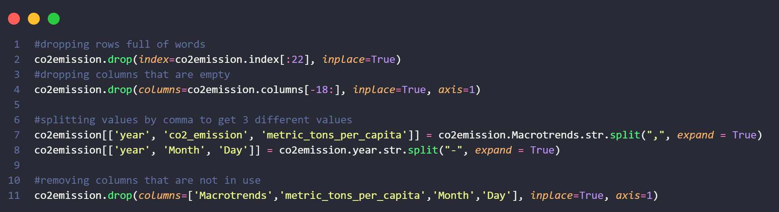
Cleaning Data (CO2 Emissions)
After converting the dataset to a JSON file, the raw file was not formatted properly
Dropped all description and empty columns with .drop
Added new columns by splitting first by , and then splitting date by –
Dropping columns that are not of use

Slide 19
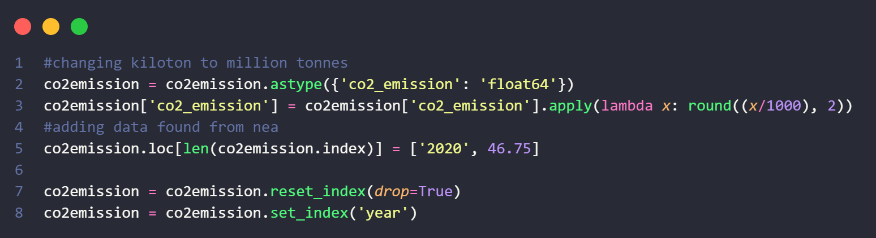
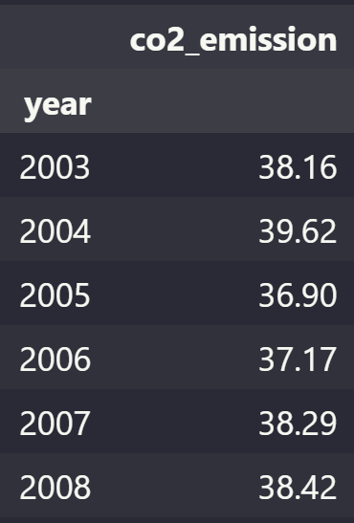
Cleaning Data (CO2 Emissions)
After splitting the string, the emissions values were of string data type
Changed data type with .astype function
Converting units of measurement from kilotons to million tonnes to match with other datasets with ,apply(lambda function)
As data was only until 2019, added supplemental data from NEA (https://www.nea.gov.sg/our-services/climate-change-energy-efficiency/climate-change/greenhouse-gas-inventory#:~:text=Singapore's%20greenhouse%20gas%20emissions%20in,Gg)%20CO2-equivalent. )

Slide 20
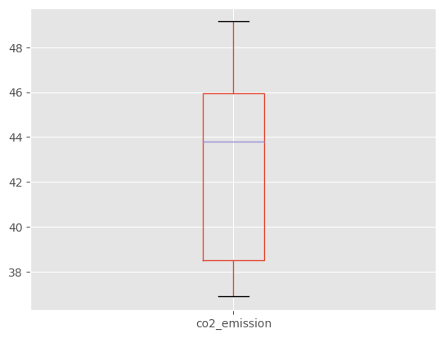
Cleaning Data (CO2 Emissions)
Check for outliers
No outliers found

Slide 21
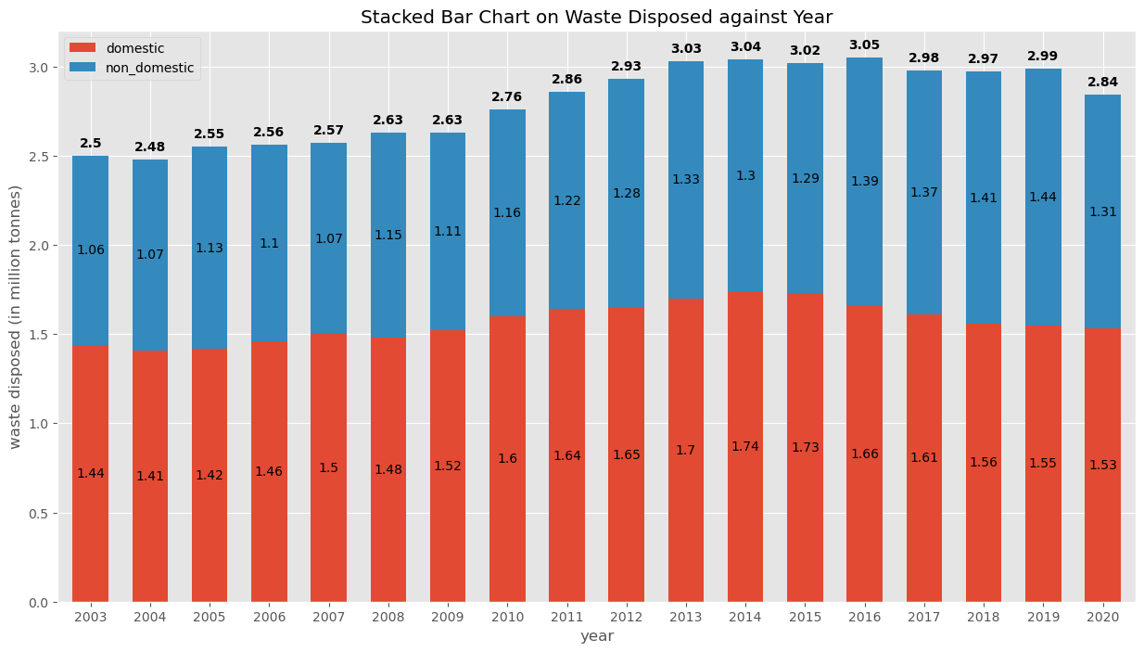
Data Analysis
The total waste disposed has generally increased over the years, with a bit of a drop from after 2016
2016 had the most disposed waste, with 3.05 million tonnes
There has always been more domestic waste disposed compared to non-domestic waste
Most domestic waste disposed was in 2014 (1.74 mil tonnes)
Most non-domestic waste disposed was in 2019 (1.44 mil tonnes)
Domestic waste disposed has been decreasing while non-domestic waste disposed has been increasing

Slide 22
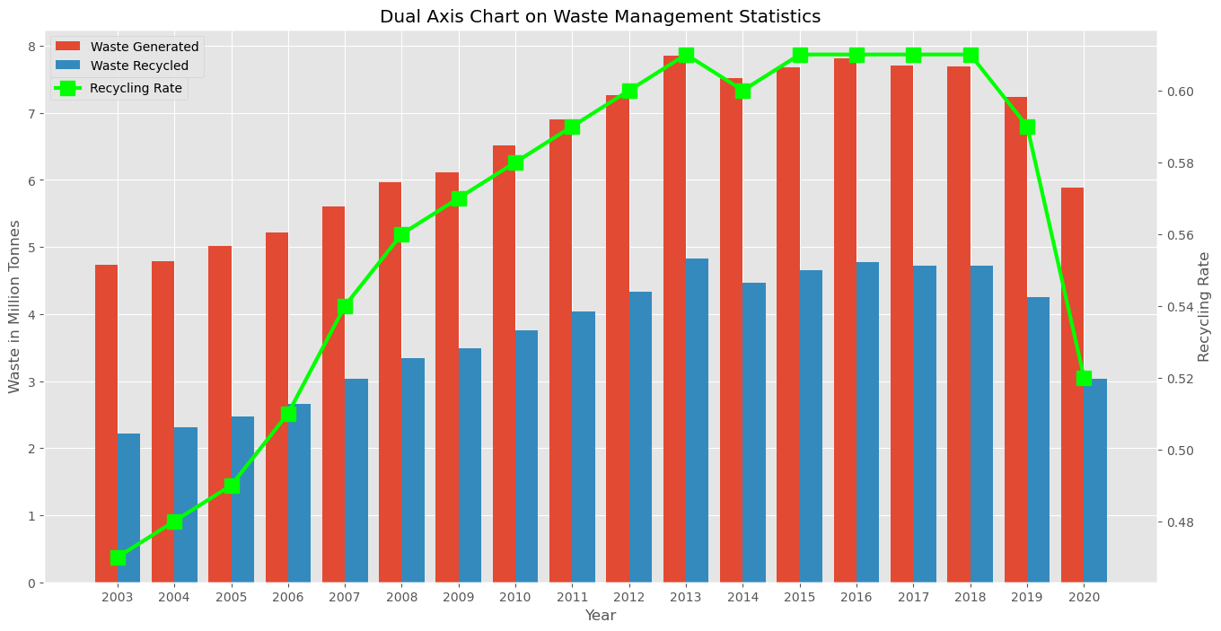
Data Analysis
The trends for generated waste and recycled waste are about the same, with the amounts increasing from 2003-2013, staying about the same from 2014-2018 and dropping after that
2013 had the highest generated waste, recycled waste and recycling rate

Slide 23
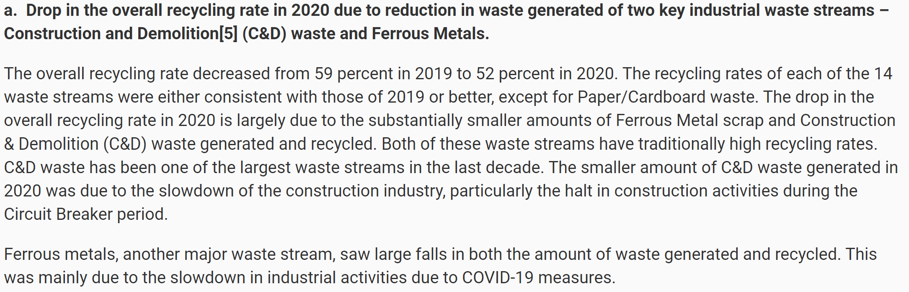
Data Analysis
The recycling rate dropped after 2018, with a big fall from 2019 to 2020.
Largely due to 2 waste types: Construction and Demolition wastes and Ferrous Metals
https://www.nea.gov.sg/media/news/news/index/reduction-in-overall-waste-generation-in-2020-with-less-waste-sent-to-semakau-landfill

Slide 24
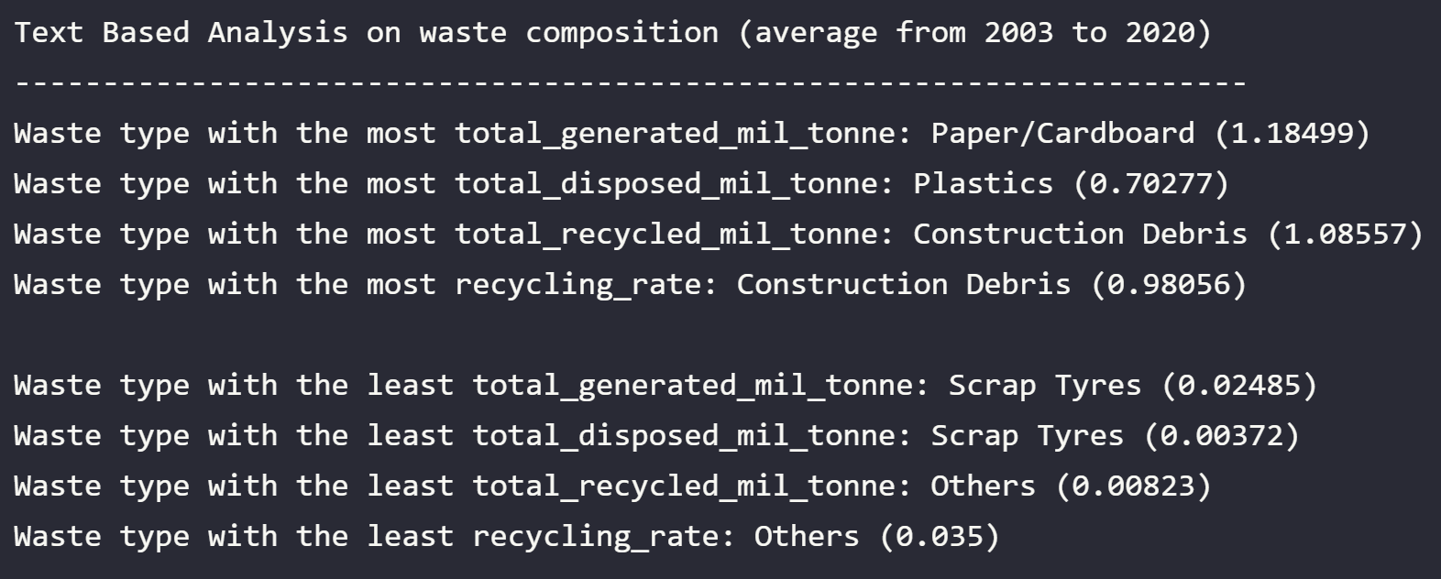
Data Analysis
Text based analysis on average waste composition from 2003 to 2020
Others → stones, ceramic, rubber, etc.

Slide 25
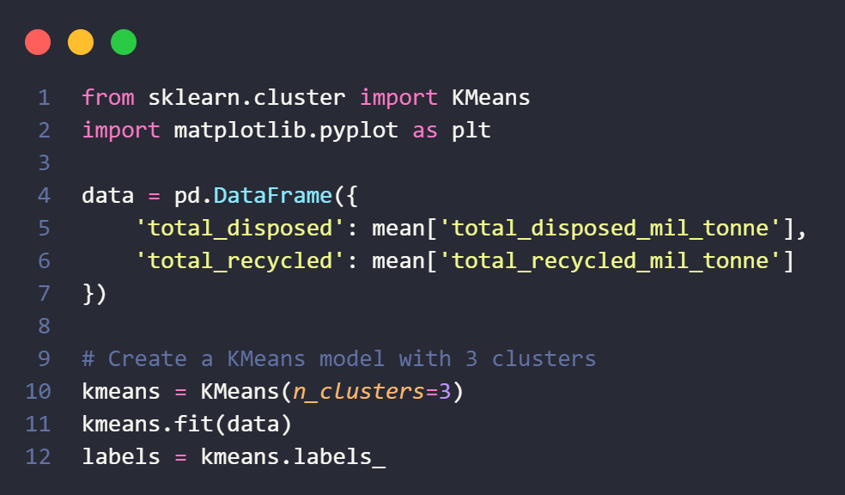
Data Analysis
Cluster Analysis on average waste composition from 2003-2020
Used the KMeans library from scikit-learn
Divides the data into 3 clusters, and then finds the centroid of each cluster

Slide 26
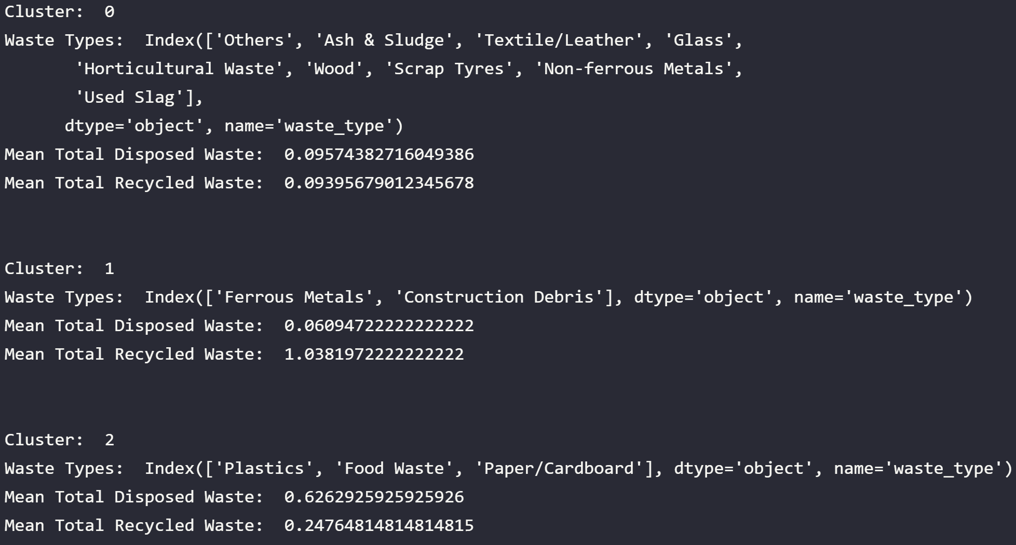
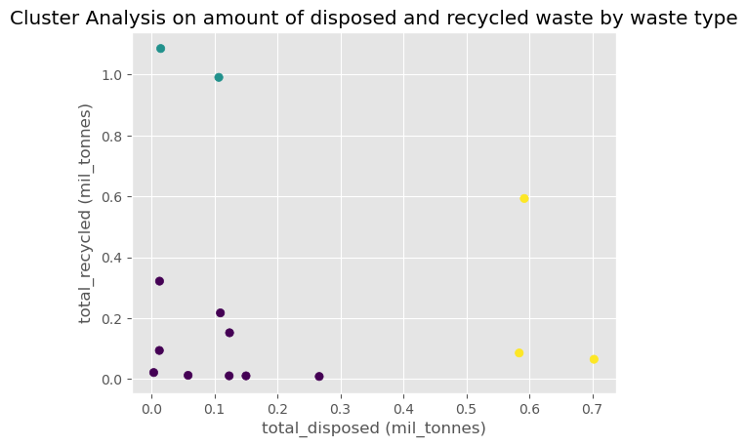
Data Analysis
Green Cluster: Ferrous Metals & Construction Debris (Little disposed, Most recycled)
Yellow Cluster: Plastics, Food Waste, Paper/Cardboard (Most disposed, Little recycled)
Purple Cluster: Glass, Wood, Textile/Leather, etc. (Little disposed, Little recycled)
Most concerning is the Yellow Cluster

Slide 27

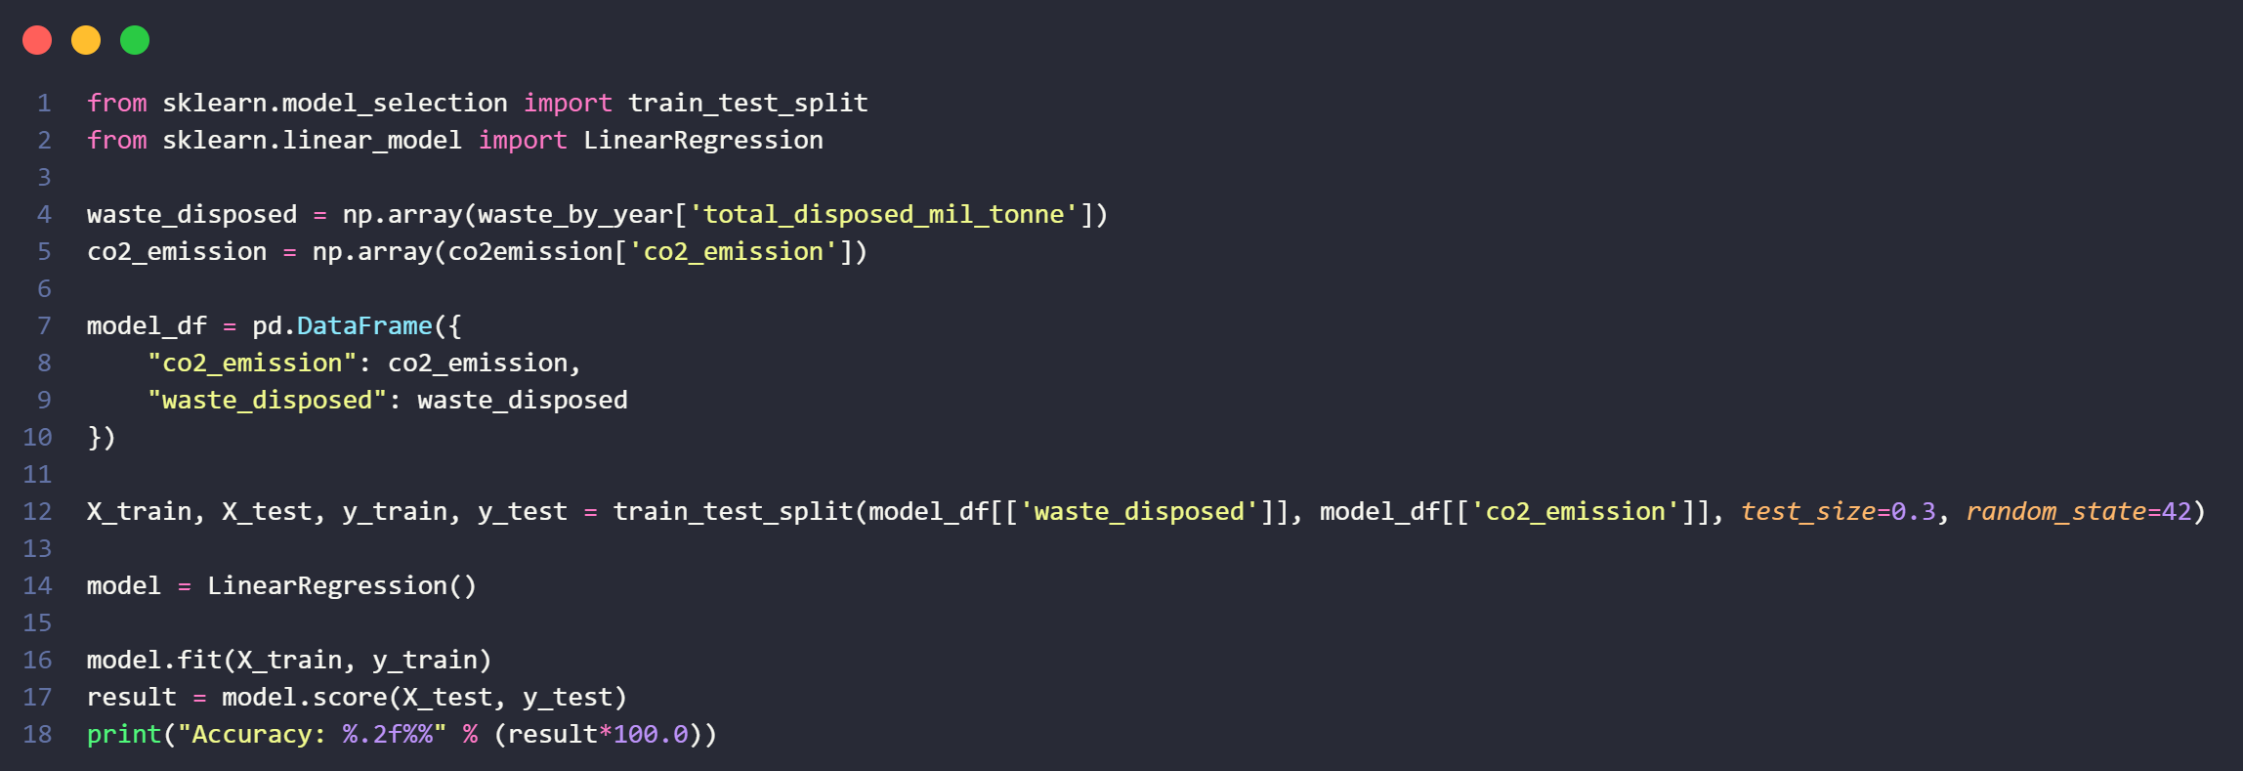
Data Analysis
Performing model validation before doing statsmodels analysis
Performed a model validation technique called train-test-split with scikit-learn to evaluate the model
Achieved a model score of

Slide 28
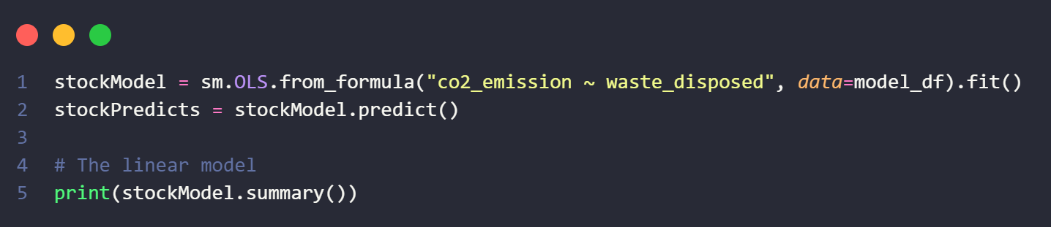
Data Analysis
Perform statsmodels Linear Regression

Slide 29
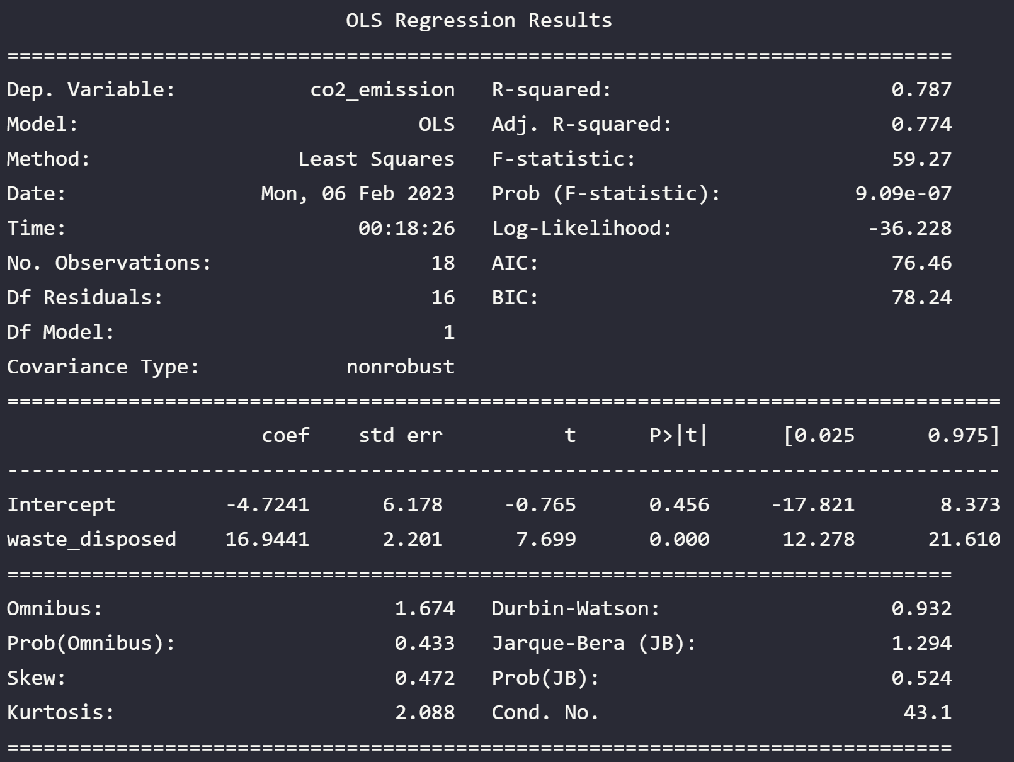
Data Analysis
CO2 Emissions against Disposed Waste
R-squared value is 0.787, which means that the model is a good fit
The linear model
CO2 Emissions = -4.7241 + 16.9441*(Waste Disposed)

Slide 30
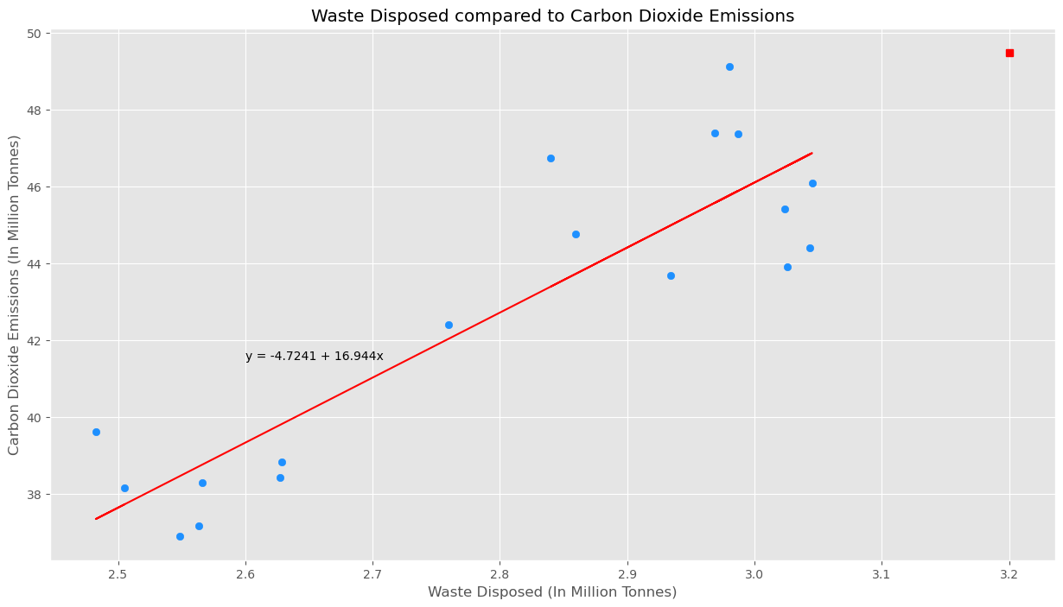
Data Analysis
Scatter Plot on CO2 emissions against waste disposed
As waste disposed increases, carbon dioxide emissions increase
np.corrcoef = 0.887, indicating a strong positive relationship
Using the model, predicted carbon dioxide emissions will be 49.497 million tonnes if the waste disposed reaches 3.2 million tonnes

Slide 31
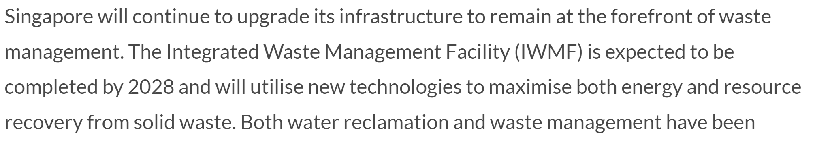
Conclusion
As COVID-19 is becoming part of life and Singapore starts to go back to normal, the waste generated might start to increase, and we have to be prepared
Relevant authorities should look further into trying to combat plastic, food and paper wastes as well as other wastes to make sure the environment improves
Everyone should play their part in waste management, from recycling to many other initiatives to make Singapore cleaner and greener
https://www.sg101.gov.sg/infrastructure/case-studies/wm

Slide 32
THANKS
Please keep this slide for attribution

